Slide 1
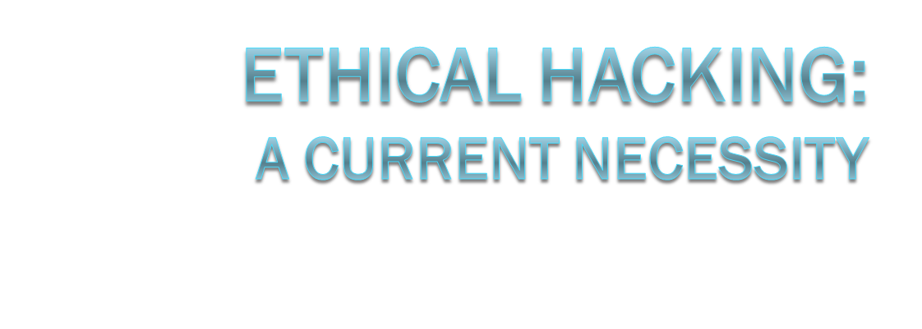
Brad Motley
CSCI392
Spring 2010
Notes:
My research paper was on Ethical Hacking and how today it is a current necessity.

Slide 2
Thesis
“With our dependence on computers & computing systems growing stronger every day, and the rapidly quickening pace of software and device capabilities, I will explain why ethical hacking is a necessary must-have that needs to be understood and applied, for the good of the community.”

Slide 3
Problems
Knowledge About the Topic of Ethical Hacking
Advancements in Computing Technology
Availability of Computer/Information Systems
Increase in Malware Production
Poor Decision Making
Notes:
Some of the problems involving ethical hacking are shown here.
- Knowledge about the topic of ethical hacking is one.
- Advancements in Computing Technology have also contributed.
- Cheap, Powerful, Mobile computing has allowed computers to be everywhere.
- Availability of Computer/Information Systems
- The previous problem has allowed computers to be everywhere and in everything. This means more users, more hackers, and more targets.
- Increase in Malware Production
- Malware production has been on a steep incline for the past 2 to 3 years.
- Poor Decision Making
- Many users are not updating software when prompted for updates. Many companies are not taking the right steps to ensure network security (for cost reasons).

Slide 4
Hacking
“The act of circumventing computer security.”
Black-Hat
  Unauthorized break-ins (malicious intent)
White-Hat
  Debug or correct security vulnerabilities
Gray-Hat
  Morally Ambiguous. Black-Hat skills, White-Hat tasks?
Notes:
Hacking – “The act of circumventing computer security”
- Did not originally have negative connotations like it does today.
- Originally Stanford and MIT students who learned the innards of how their computers were connected and the workings behind it.
- Negative today because of all the testing and reconnaissance involved in cracking or subverting systems.
Black-Hat
Malicious Hackers. Called this because of the bad guys in westerns who wore black hats.
White-Hat
Ethical Hackers. Called this because they are the counter-parts to Black-hats
Gray-Hat
Morally Ambiguous Hackers. Like Robin Hood steals from the rich and gives to the poor. Commit illegal acts in the name of good. Called this because they are hybrids of Black & White.

Slide 5

3:10 to Yuma

Slide 6
Ethical Hacking
“Fixing the system by compromising it”
  Often through destructive testing
White-Hat
  Main focus: secure/protect IT systems
Notes:
We’ll talk a little more about this on the next few slides.

Slide 7
Why is Ethical Hacking Significant?
To ensure the protection and privacy of personally identifiable and/or sensitive information.
The state of security on the internet is poor and the progress toward increased protection is slow.
Ex: Defender’s Dilemma
Notes:
With companies storing more and more information about people, empoyees, etc. more of our privacy is being sacrificed, especially if it gets into the wrong hands.
Defenders Dilemma: has Military Application and refers to a difficult tactical measure.
- When a defender’s resources grow and become more desirable, so will the number of attackers.
- The defender now has to secure more assets against a greater threat (both in number and in strength).
- The attackers need only to find one point of entry to exploit and compromise the defender.
- Ironically, the defender must defend every potential point of attack.
As we can see, this issue presents a tough situation. This is the situation of network security.

Slide 8



Defender’s Dilemma

Slide 9
How to Utilize Ethical Hacking?
Employ ethical hackers to assist in insuring network integrity
But who do we hire and how do we know what to look for?

Slide 10
Who to Hire?
Trainees?
  Clean slate
  Record of knowledge
Reformed Ex Black-Hats?
  Skills
  Real world experience (Insider Knowledge)
  Moral Issue?
Notes:
We can train our own employees, or hire trained ones at places like ISS.com:
- They have a clean slate
- Appear fresh for molding into our business practice
- They have a record of knowledge for which we can see beforehand what they know and where they learned it.
We can also hire reformed black-hat hackers:
- They have the skills and the insider knowledge that ultimately we want to utilize for protection and counter-measures.
- They have them because they are interested in it, good at it, and probably learned themselves.
- They have real world experience out of the box with potentially various different situations.
But what about the Moral issue of this?
- You’re hiring someone who is admitting that they once commited crimes.
- Outward Message: Promoting criminal activity? Bad habits? Illegal acts pay off in the end?
- You’re going to be giving them access to sensitive information and free roam on your network.
- They will have the ability to acquire access to private personal information in some cases.
- They have the ability to do it without getting caught, can you trust them?

Slide 11
Potential Consequences
Vulnerabilities Exploited
  Malware Infection
  Hackers gain access
  Network Downtime
Sensitive Information Loss
  Lawsuits
  Bad Reputation
  Loss of Capital
Notes:
The consequences of not employing some form of ethical hacking or proactive means of ensuring network security to the best means available are:

Slide 12
Conclusion
“The Best Defense is a Good Offense”
Employing ethical hackers to assist in Network Security is a great counter-measure.
  Their insider knowledge gives outsiders less of an “edge”.
Notes:
Even if they can’t prevent 100% of attacks, quick cleanup and rectification is an important means of damage control.

Slide 13
Other Facts
Estimated that 90% of all Internet attacks would be deterred with current versions/updates.
In 2008, 1 website hacked every 5 seconds.

Slide 14
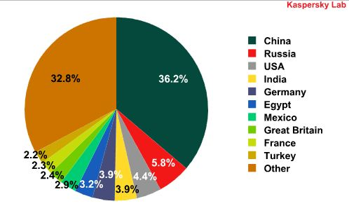
Other Facts
Over the last 3-4 years, China has become the leading source of malware. In 2009 alone, Kaspersky Lab detected 73,619,767 network attacks, of which 52.7% originated from Internet resources in China. – Kaspersky Labs

Slide 15
Interesting Links
Noah Schiffman: http://www.networkworld.com/community/blog/5035
http://iase.disa.mil/eta/iaav8/index.htm
http://iase.disa.mil/eta/phishing/Phishing/module.htm
http://iase.disa.mil/eta/pii/pii_module/pii_module/module.htm

Slide 16
References
Kaspersky Labs
http://www.kaspersky.com/news?id=207576026
Noah Schiffman, M.D., reformed black-hat, turned gray-hat, now white-hat.
http://www.networkworld.com/community/blog/5035
Simpson, Michael. Hands on ethical hacking and network defense. 1st ed. Course Technology, 2005. 214-19. Print.
Rockenbach, Barbara, Mendina Tom, and Almagno Stephen. "Ethical Hacking: The Security Justification."Ethics and Electronic Information. Jefferson, NC: MacFarland & Company, Inc. Publishers, 2002. Print.
Norfolk, David. "Understanding Ethical Hacking." PC Network Advisor: Management & Strategy Overview 128 (2001): 7-12. Web. 29 Mar 2010. http://www.techsupportalert.com/pdf/m04133.pdf.

Slide 17
The End

